Slide 1



PowerBi Project
View in Power BI
Last data refresh:
24/08/2022 14:41:40 UTC
Downloaded at:
24/08/2022 14:42:30 UTC

Slide 2
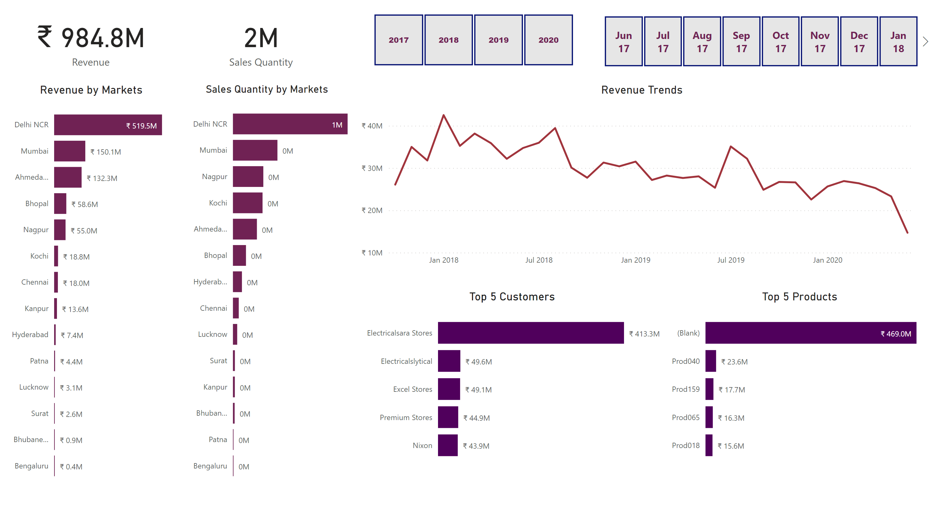
Page 1
Notes:
card
No alt text provided
card
No alt text provided
Revenue by Markets
No alt text provided
Sales Quantity by Markets
No alt text provided
slicer
No alt text provided
slicer
No alt text provided
Top 5 Customers
No alt text provided
Top 5 Products
No alt text provided
Revenue Trends
No alt text provided

Slide 3
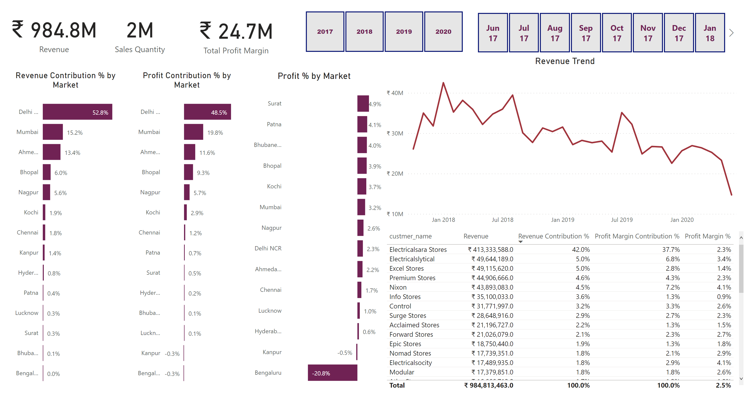
Duplicate of Page 1
Notes:
card
No alt text provided
card
No alt text provided
Profit % by Market
No alt text provided
Profit Contribution % by Market
No alt text provided
slicer
No alt text provided
slicer
No alt text provided
Top 5 Customers
No alt text provided
Revenue Trend
No alt text provided
card
No alt text provided
Revenue Contribution % by Market
No alt text provided

